Slide 1
Where is it? Location Tags are the Key
erin buchanan

Slide 2
History
Treisman
  Visual search, people make errors
Prinzmetal
  These errors might be due to bad location tags

Slide 3
Errors
People make several types of errors:
  Illusory Conjunctions
  Letter Errors
  Color Errors
  Guesses

Slide 4
My Research
Errors in feature binding occur
Errors are occurring during attention
What’s influencing them?
  Inhibition?
  Not Eccentricity
  Working Memory?

Slide 5
How and Why
We’ve seen how features can move and bind with others
But exactly HOW do they move?
Why do errors happen?
  Poor location tags
  Working memory

Slide 6
Why this experiment?
Previous studies all use just horizontal or vertical displays
Wanted to see how features moved in a more complicated display
  This design allows for features to move in all directions, not just uni-dimensionally

Slide 7
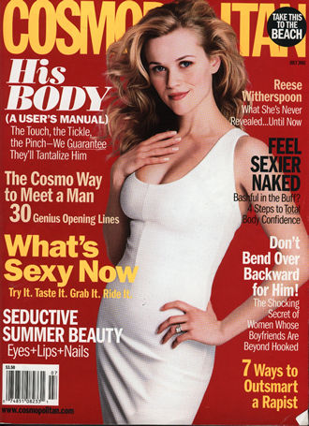

Slide 8
Design
Required participants to memorize displays of colored letters
2 seconds to study display
Then recreated the display

Slide 9
Displays
Color letter combinations were presented in a 5X5 matrix
2, 4, or 6 letter displays

Slide 10
Colors and Letters
Colors
  Red, orange, blue, brown, green, pink, black, gray, purple
Letters
  All letters from A-Y
  Excluded Z for counterbalancing

Slide 11
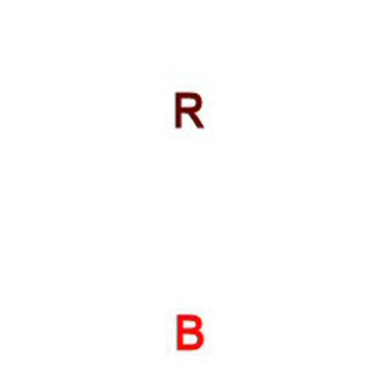

Slide 12
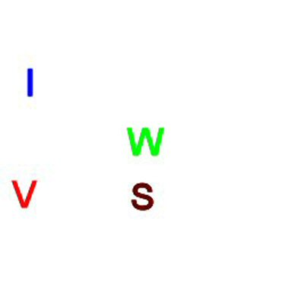

Slide 13
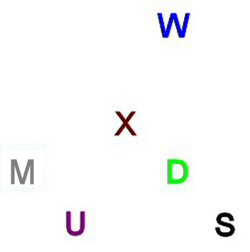

Slide 14
Example of the Experiment
Notes:
HIT ESCAPE TO GET OUT OF OTHER PROGRAM

Slide 15
Coding
Correct Answers
Moved Answers
Errors
  Letter, Color intrusions
  Movement errors
Thrown out single answers

Slide 16
T | 1H | 2H | 3H | 4H
1V | 1.41D | 2.24D | 3.16D | 4.12D
2V | 2.24D | 2.83D | 3.61D | 4.47D
3V | 3.16D | 3.61D | 4.24D | 5D
4V | 4.12D | 4.47D | 5D | 5.67D

Slide 17
2D | 2D | 2V | 2D | 2D
2D | 1D | 1V | 1D | 2D
2H | 1H | T | 1H | 2H
2D | 1D | 1V | 1D | 2D
2D | 2D | 2V | 2D | 2D

Slide 18
3.16D | 2.24D | 1.41D | 1V | 1.41D
3H | 2H | 1H | T | 1H
3.16D | 2.24D | 1.41D | 1V | 1.41D
3.61D | 2.83D | 2.24D | 2V | 2.24D
4.24D | 3.61D | 3.16D | 3V | 3.16D

Slide 19
Hypotheses
Increasing difficulty with more items
Horizontal - Vertical same?
Diagonal errors are different
Location Tags
  More 1 / 2 errors indicating that the general area gets tagged

Slide 20
Results
Correct Percentages
  Moved Error Corrections
Letter, Color Intrusions
Errors by Movement Type

Slide 21
Correct Answers

Slide 22
Correct by Number of Items
Notes:
78-91
30-45
18-23

Slide 23
Letter and Color Intrusions
Notes:
Need to show that these happen on our displays - to show that it is like normal feature binding experiments.

Slide 24
Errors By Movement
2 item displays - no errors
Calculated
  Number of errors / number of possible
Left-right, up-down
  All the same, so combined
Statistics! Eeek!

Slide 25
4 Item
Horizontal Errors
Vertical Errors

Slide 26
Diagonal 4 Items

Slide 27
Summary 4 Items
Horizontal - Vertical are basically the same
Linear functions
Diagonal
  Quadratic curve

Slide 28
Horizontal 6 Items

Slide 29
Vertical 6 Items

Slide 30
Diagonal 6 Items

Slide 31
Summary 6 Items
Horizontal - Vertical are not the same
  Horizontal positive slope?
Linear Function
Diagonal
  Still better explained by a curve function

Slide 32
Diagonal = Different

Slide 33
What’s going on?
Individual differences?
  Working memory
Experiment 2
  Currently underway
  Same procedure with OSPAN as a measure of working memory

Slide 34
Tentative Results
Percent Correct Overall
Percent Correct by Display

Slide 35
Horizontal 4 Items
Notes:
N = 23
Lo = 8
Mid = 8
Hi = 7

Slide 36
Vertical 4 Items

Slide 37
Diagonal 4 Items

Slide 38
Horizontal 6 Items

Slide 39
Vertical 6 Items

Slide 40
Diagonal 6 Items

Slide 41
Why Differences?

Slide 42
The Answer
Diagonal Errors are different
Working memory may help explain this
Features do move in a dynamic matter.
  Poor location tagging seems to be the key.

